Slide 1
Applied Data Science Capstone
Preksha Tiwari

Slide 2
Outline
Business Objective
Data Understanding and cleaning
Data Analysis
4. Clustering Approach
5. Result

Slide 3
Introduction:
The purpose of this Capstone Project is to :
Help people in exploring better facilities around their neighbourhood in the city of Toronto and New York. It will help people making smart and efficient decision on selecting great neighbourhood out of numbers of other neighbourhoods and
ii) To determine the best possible location to open an Restaurant on the different localities of the Toronto city based on the ease of accessibility by maximum number of people so that the revenue from the latest venture can be maximized, So need to choose the correct location to start their first venture(restaurants).

Slide 4
Problem Description:
Finding a nice neighborhood to live in.
Various factors need to be studied in order to decide on the neighborhood
1. Public Places
2. places to have leisure activities like going to restaurants, movie theaters, saunas, gym, etc.,
And
Finding a place for new restaurant in the city of Toronto.
Various factors need to be studied in order to decide on the Location such as: 1. Population 2. Demographics 3. Who are the competitors in that location? 4. Segmentation of the Borough

Slide 5
Data:
Data Wrangling
A lot of hard work went into creating the working data set. I had to combine the following disparate data sources. The order of events went like this
1. Load all the Data from all the various sources for city of Toronto and New York
i) Toronto neighborhoods broken down by postal code
https://en.wikipedia.org/wiki/List_of_postal_codes_of_Canada:_M Here I used BeautifulSoup to scrape the wiki page to extract a working list of Toronto Neighborhoods sorted by postal code.
ii) Load Toronto geospatial coordinates and merge to Toronto Postal Code Data
http://cocl.us/Geospatial_data Next, I joined geo spatial to the Toronto Data.
iii) Merge Toronto Neighbourhood populations data with Toronto Postal Code data
Next, I joined population data to the Toronto Data.
iv) New York neighborhoods broken down by postal code
https://cf-courses-data.s3.us.cloud-object-storage.appdomain.cloud/IBMDeveloperSkillsNetwork- DS0701EN-SkillsNetwork/labs/newyork_data.json

Slide 6
Data cont’d:
Foursquare API Data: We will need data about different venues in different neighbourhoods of that specific borough. To gain that information, we will use “Foursquare” locational information. Foursquare is a location data provider with information about all manner of venues and events within an area of interest. Such information includes venue names, locations, menus and even photos.
After finding the list of neighbourhoods, we then connect to the Foursquare API to gather information about venues inside each neighbourhood. For each neighbourhood, we have chosen the radius to be 250 meters.
The data retrieved from Foursquare contained information of venues within a specified distance of the longitude and latitude of the postcodes. The information obtained per venue as follows:
Neighborhood
Neighborhood Latitude
Neighborhood Longitude
Venue
Name of the venue e.g. the name of a store or restaurant
Venue Latitude
Venue Longitude
Venue Category

Slide 7
Methodology:
1. Getting the co-ordinates of the target city.
2. Getting the list of neighborhoods and their co-ordinates.
3. Exploring the most visited venues in the target localities.
Clustering the localities.
4. Analyzing the clusters formed.
5. Collecting information about the type of restaurants already present in a locality.
Public Programming Tools like Folium to visualize the neighborhoods in the city.Then based upon the analysis of the Foursquare information we can update the Folium visualization to reflect the number of amenities in a neighborhood
6. K-Means Clustering Algorithm to group amenities in an area, then we can reduce the number of individual amenities comparisons to be done against each neighborhood. We can do these comparisons against the types of amenities, individually and collectively.

Slide 8
Methodology cont’d:
Choosing the correct number of clusters.
Here I use Silhouette analysis to determine the optimum number of clusters to use.
A backgrounder on Silhouette analysis.
“We can use Silhouette analysis to evaluate each model. A Silhouette coefficient is calculated for observation, which is then averaged to determine the Silhouette score. The coefficient combines the average within-cluster distance with average nearest-cluster distance to assign a value between -1 and 1. A value below zero denotes that the observation is probably in the wrong cluster and a value closer to 1 denotes that the observation is a great fit for the cluster and clearly separated from other clusters. This coefficient essentially measures how close an observation is to neighboring clusters, where it is desirable to be the maximum distance possible from neighboring clusters. We can automatically determine the best number of clusters, k, by selecting the model which yields the highest Silhouette score.”
* Key Observation: My highest score was 6. *

Slide 9
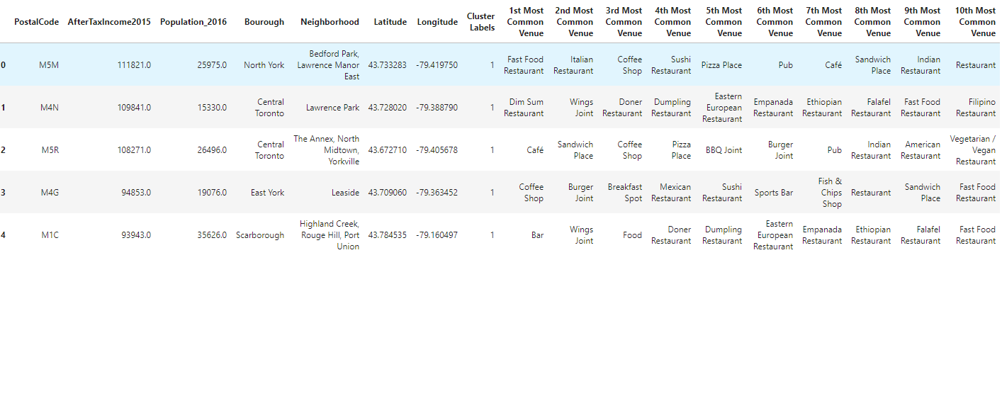
Methodology cont’d:
2.2 Merge the Toronto data with geo coordinates data and make sure it's the right shape
Here I reshape the Toronto data so that it’s shape matches the clustered data.
2.3 Add the KMeans Labels
Determine the largest cluster in this case it was cluster number 2 with a shape of (76, 15)

Slide 10
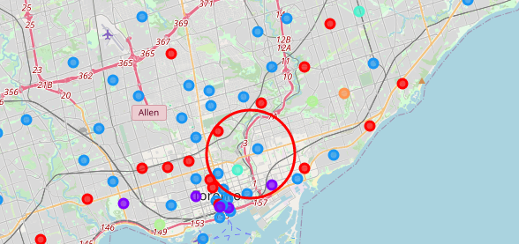
Results:
4.1 Plot the clusters on a Map of the Toronto and Super Impose the best location of a Store i.e. Central Toronto

Slide 11
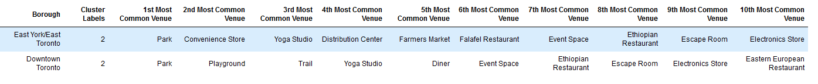
Results:
4.2 Cluster analysis for Neighborhood or Toronto City : Central Toronto ,Downtown and East Toronto
Based on the individual preferences they can opt for location change either in Central , East or Downtown Toronto

Slide 12
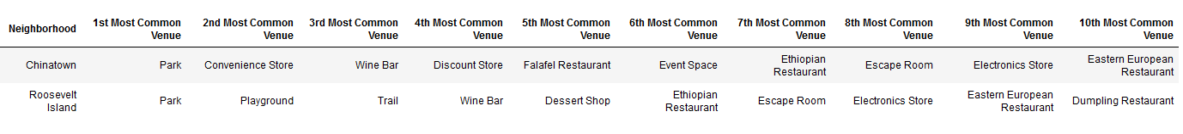
Results:
4.2 Cluster analysis for Neighborhood of New York City : Chinatown, Soho and Roosevelt Island
Based on the individual preferences they can opt for location change either in Chinatown, Soho and Roosevelt Island

Slide 13
Conclusion:
1) If you need to find a nice neighbourhood to live in Toronto city you can either go for the Central Toronto, Downtown or East Toronto based on the individual preferences
Like if you mostly looking for park your first choice to be Downtown or in case if you are looking for best restaurant your first choice will be Central Toronto
2) Similarly , find a nice neighbourhood to live in New York Manhattan city you can either go for the Chinatown, Soho and Roosevelt Island based on the individual preferences
Like if you mostly looking for park your first choice to be Roosevelt Island or in case if you are looking for best home-services your first choice will be Soho.
3) Central Toronto has more places in Toronto when compared to all remaining neighborhoods. So, when a person wants to relocate based upon all the available public amenities, they can recognize that Downtown Toronto is the best of all the available options. The above deductions is purely done based upon the quantity of the public amenities available and not on the quality of these services.

